Slide 1
Enhanced Entity Relationship Modeling
CSC311A - Database Systems
B. Tech. 2014
Course Leader:
Gp Cpt N. Rath VSM
Ami Rai E.

Slide 2
Objectives
At the end of this lecture, student will be able to
explain the concept of EER modeling

Slide 3
Topics
Subclasses/superclasses
Specialization/generalization
Attribute and relationship inheritance
Categories (UNION types)

Slide 4
Subclasses and Superclasses
An entity type may have additional meaningful subgroupings of its entities
Example: EMPLOYEE may be further grouped into
SECRETARY, ENGINEER, TECHNICIAN, …
Based on the EMPLOYEE’s Job
MANAGER
EMPLOYEEs who are managers
SALARIED_EMPLOYEE, HOURLY_EMPLOYEE
Based on the EMPLOYEE’s method of pay
EER diagrams extend ER diagrams to represent these additional subgroupings, called subclasses or subtypes

Slide 5
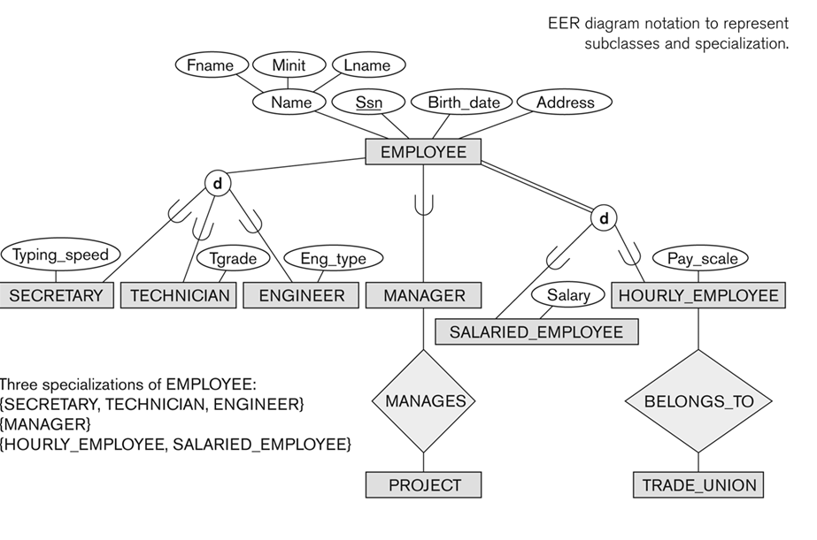
Subclasses and Superclasses

Slide 6
Subclasses and Superclasses contd.
Each of these subgroupings is a subset of EMPLOYEE entities
Each is called a subclass of EMPLOYEE
EMPLOYEE is the superclass for each of these subclasses
These are called superclass/subclass relationships
EMPLOYEE/SECRETARY
EMPLOYEE/TECHNICIAN
EMPLOYEE/MANAGER
…
These are also called IS-A relationships
SECRETARY IS-A EMPLOYEE, TECHNICIAN IS-A EMPLOYEE, ….

Slide 7
Subclasses and Superclasses contd.
A member of the superclass can be optionally included as a member of any number of its subclasses
Examples:
A salaried employee who is also an engineer belongs to the two subclasses
ENGINEER
SALARIED_EMPLOYEE
A salaried employee who is also an engineering manager belongs to the three subclasses:
MANAGER
ENGINEER, and
SALARIED_EMPLOYEE
It is not necessary that every entity in a superclass be a member of some subclass

Slide 8
Attribute Inheritance in Superclass/Subclass Relationships
An entity that is member of a subclass inherits
All attributes of the entity as a member of the superclass
All relationships of the entity as a member of the superclass
Example:
In the slide No.5, SECRETARY (as well as TECHNICIAN and ENGINEER) inherit the attributes Name, SSN, …, from EMPLOYEE
Every SECRETARY entity will have values for the inherited attributes

Slide 9
Specialization
Specialization is the process of defining a set of subclasses of a superclass
The set of subclasses is based upon some distinguishing characteristics of the entities in the superclass
May have several specializations of the same superclass
Example: {SECRETARY, ENGINEER, TECHNICIAN} is a specialization of EMPLOYEE based upon job type
Example: Another specialization of EMPLOYEE based on method of pay is {SALARIED_EMPLOYEE, HOURLY_EMPLOYEE}

Slide 10
Specialization contd.
Attributes of a subclass are called specific or local attributes
For example, the attribute TypingSpeed of SECRETARY
The subclass can also participate in specific relationship types
For example, a relationship BELONGS_TO of HOURLY_EMPLOYEE
The specialization process allows us to do the following
Define a set of subclasses of an entity type
Establish additional specific attributes with each subclass
Establish additional specific relationship types between each subclass and other entity types or other subclasses

Slide 11
Generalization
Generalization is the reverse of the specialization process
Several classes with common features are generalized into a superclass
original classes become its subclasses
Example:
CAR, TRUCK generalized into VEHICLE
both CAR, TRUCK become subclasses of the superclass VEHICLE
We can view {CAR, TRUCK} as a specialization of VEHICLE
Alternatively, we can view VEHICLE as a generalization of CAR and TRUCK

Slide 12
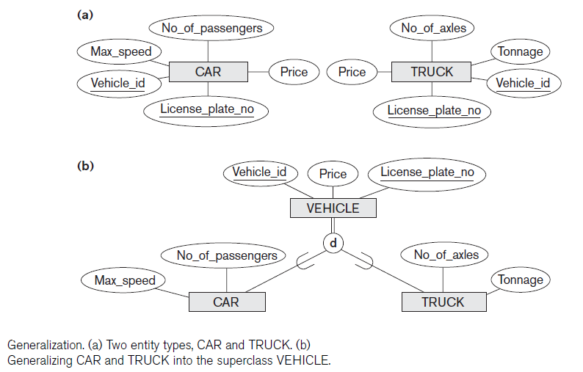
Generalization - Example

Slide 13
Constraints on Specialization and Generalization
If we can determine exactly those entities that will become members of each subclass by a condition, the subclasses are called predicate-defined (or condition-defined) subclasses
Condition is a constraint that determines subclass members
Display a predicate-defined subclass by writing the predicate condition next to the line attaching the subclass to its superclass
Example: we can specify the condition of membership in the SECRETARY subclass by the condition (Job_type=‘Secretary’), which is the defining predicate of the subclass

Slide 14
Constraints on Specialization and Generalization contd.
If all subclasses in a specialization have membership condition on same attribute of the superclass, specialization is called an attribute-defined specialization
Attribute is called the defining attribute of the specialization
Example: JobType is the defining attribute of the specialization {SECRETARY, TECHNICIAN, ENGINEER} of EMPLOYEE
If no condition determines membership, the subclass is called user-defined
Membership in a subclass is determined by the database users by applying an operation to add an entity to the subclass
Membership in the subclass is specified individually for each entity in the superclass by the user

Slide 15
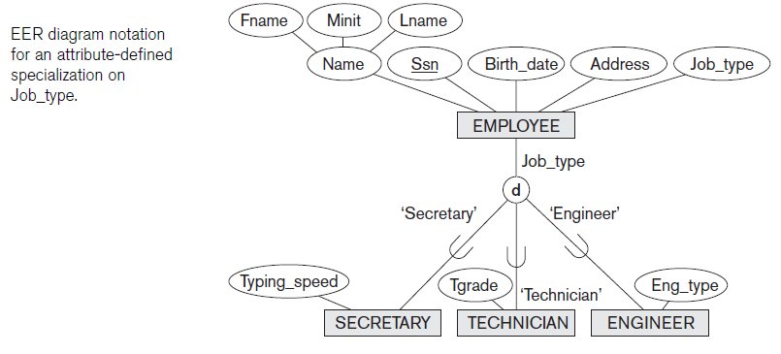
Displaying an Attribute-defined Specialization

Slide 16
Constraints on Specialization and Generalization
Two basic constraints can apply to a specialization/generalization
Disjointness Constraint
Completeness Constraint

Slide 17
Disjointness Constraint
Specifies that the subclasses of the specialization must be disjoint
an entity can be a member of at most one of the subclasses of the specialization
Specified by d in EER diagram
If not disjoint, specialization is overlapping
the same entity may be a member of more than one subclass of the specialization
Specified by o in EER diagram

Slide 18
Completeness (Totalness) Constraint
Total specifies that every entity in the superclass must be a member of some subclass in the specialization/generalization
Shown in EER diagrams by a double line
Partial allows an entity not to belong to any of the subclasses
Shown in EER diagrams by a single line

Slide 19
Hierarchies & Lattices
A subclass may itself have further subclasses specified on it
forms a hierarchy or a lattice
Hierarchy
has a constraint that every subclass has only one superclass (called single inheritance)
this is basically a tree structure
Lattice
a subclass can be subclass of more than one superclass (called multiple inheritance)
In a lattice or hierarchy, a subclass inherits attributes not only of its direct superclass, but also of all its predecessor superclasses

Slide 20
Shared Subclass
Shared subclass
A subclass with more than one superclass
It directly inherits attributes and relationships from multiple classes
Existence of at least one shared subclass leads to a lattice and hence to multiple inheritance

Slide 21
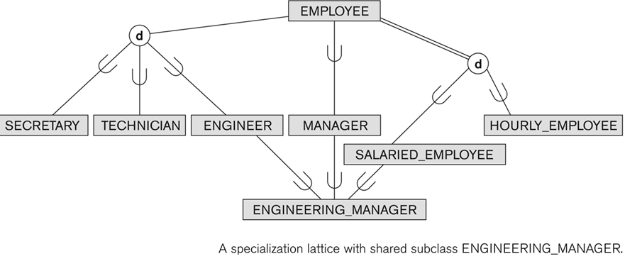
Shared Subclass “Engineering_Manager”

Slide 22
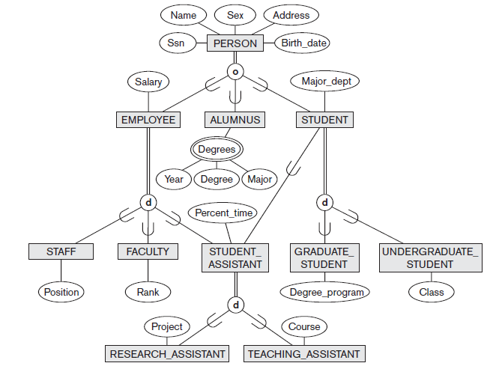
A Specialization Lattice with Multiple Inheritance

Slide 23
General Guidelines
In specialization, start with an entity type and then define subclasses of the entity type by successive specialization
called a top down conceptual refinement process
In generalization, start with many entity types and generalize those that have common properties
Called a bottom up conceptual synthesis process
In practice, a combination of both processes is usually employed

Slide 24
Category or Union Type
Example: In a database for vehicle registration, a vehicle owner can be a PERSON, a BANK (holding a lien on a vehicle) or a COMPANY
A category (UNION type) called OWNER is created to represent a subset of the union of the three superclasses COMPANY, BANK, and PERSON
A category member must exist in at least one of its superclasses
Difference from shared subclass, which is a:
subset of the intersection of its superclasses
shared subclass member must exist in all of its superclasses

Slide 25
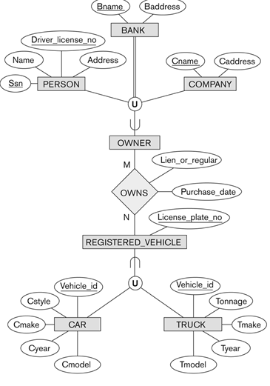
Two Categories (UNION types): OWNER, REGISTERED_VEHICLE

Slide 26
Summary
Extensions to the ER model that improve its representational capabilities – is called as the enhanced ER or EER model
There are two main processes for defining superclass/subclass hierarchies and lattices: specialization and generalization
There are various types of constraints that may apply to specialization or generalization
The two main constraints are total/partial and disjoint/overlapping
Category or union type, is a subset of the union of two or more classes

